Slide 1

Automation Testing
By- Manas

Slide 2
Select Class in Selenium | Select Class Methods
Select is a class provided by Selenium that is used to work with a dropdown element.
The select class allows us to select an element from the drop-down and lists that are created with the HTML <select> element.
The select class is present in org.openqa.selenium.support.ui package. It extends Object class and implements the ISelect interface.

Slide 3
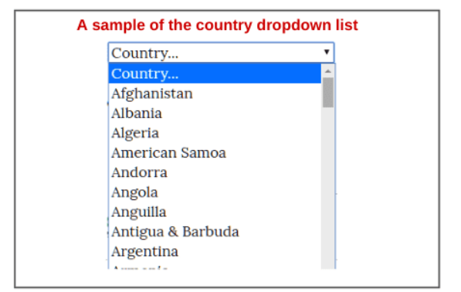
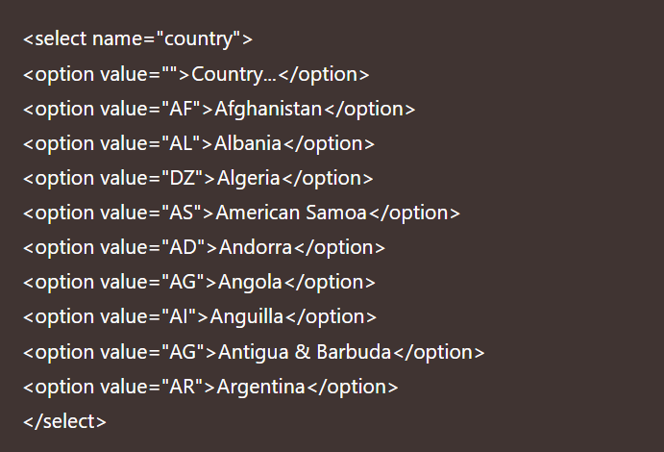

Slide 4
How to create Object of Select Class in Selenium
Since the select is an ordinary class, its object is created by using the new keyword. After creating object, we will have to pass the dropdown WebElement as parameter to its constructor.
The syntax to create an object of select class is as follows:
Select obj = new Select (WebElement element);

Slide 5
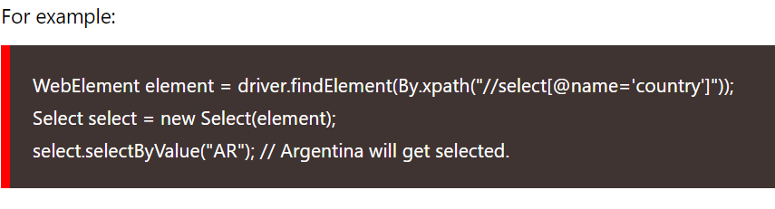
1. selectByValue
This method is used to select an option by passing a value associated with the value attribute. For example, in the previous country list, if we say selectByValue(“AR”), Argentina as a country will get selected

Slide 6
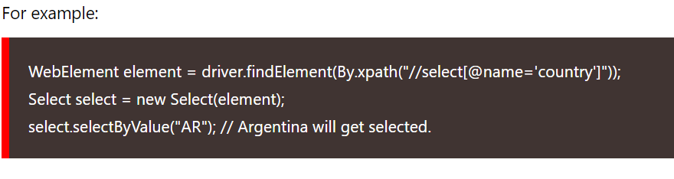
2. selectByIndex
This method is used to select an option from the dropdown list by passing an index value. The index value ranges from 0 to n – 1 where n is the total number of options in the list.

Slide 7
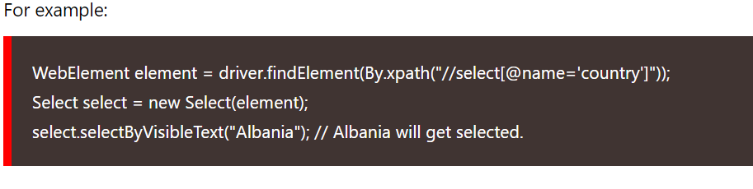
3. selectByVisibleText
This is a very easy method to choose an option from any dropdown list. It selects an option by passing the text option that we see on the screen. For example, if we want to select country Albania, we will write selectByVisibleText(“Albania”).

Slide 8
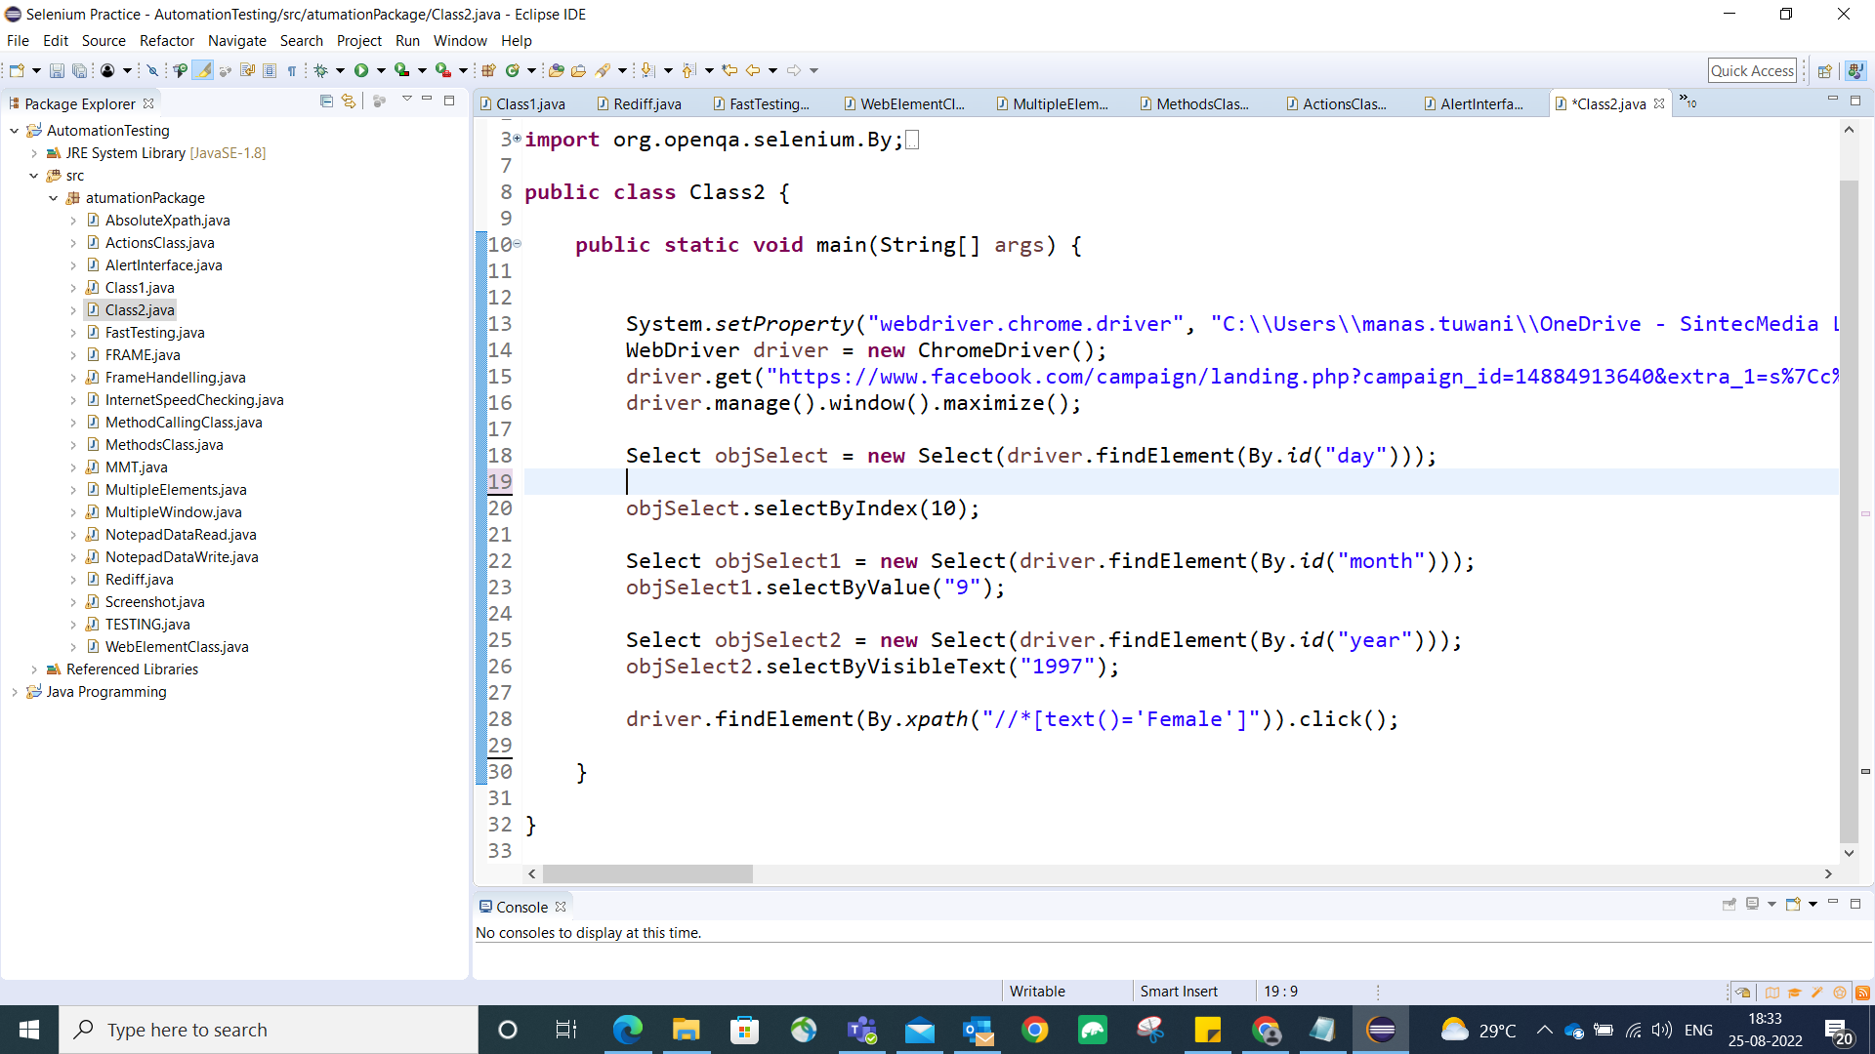

Slide 9
Common Actions on Dropdown
isMultiple(): lets you check if dropdown supports multiple selection
getOptions(): lets you get the number of all present options for selection
getFirstSelectedOption(): As name suggest it get you the first selected option from dropdown
deselectAll(): lets you deselect all the selected options
getAllSelectedOptions(): As name suggest it get you the all-selected option from dropdown

Slide 10
Practice Assignment:
Launch the chrome browser.
Open URL: https://web-locators-static-site-qa.vercel.app/Dropdown
Locate the dropdown “Which country do you want to travel”
Select “Australia” using selectByVisibleText() method
Check if this dropdown allows multiple selection
Locate the dropdown “What would you prefer to eat among the listed fruits?”
Select “Banana” using selectByIndex() method
Locate and move to the “MULTI SELECT DROPDOWN” tab
Locate the dropdown “Skills”
Check if this dropdown allows multiple selection
Few of the options are selected by default. Retrieve and print these
Close the browser

Slide 11
Navigation Commands with Example
navigate().back() – Requires no parameters and takes back the user to the previous webpage in the web browser’s history. For ex. driver.navigate().back();
navigate().forward() – Navigates to the next web page with reference to the browser’s history. For ex. driver.navigate().forward();
navigate().refresh() – This command lets you refresh the current web page there by reloading all the web elements. For ex. driver.navigate().refresh();
navigate().to() – Used to launch a new web browser window and navigate to the specified URL. For ex. driver.navigate().to(“https://google.com”);

Slide 12
